Slide 1
Aquarium and Petshop Management System

Slide 2
Abstract: Aquarium and Pet Shop Management System ,The Aquarium and Pet Shop Management System is a web-based application built using the Python Django framework. The project aims to provide an organized and efficient platform for managing a virtual aquarium and pet shop, facilitating the management of diverse aquatic life and pets. This project encompasses various features such as pet inventory management, user authentication, search and filtering and more. This Project has four users Admin, Dealer, Customer and Delivery Man. In mini project there is only three users(except Delivery Man) and In main project there are four users. In this project i am including the technologies like email verification in user login and dealer login and in main project implementing the payment technology and i would like to implement machine learning in Product showcase

Slide 3
Table Design
User Table
Column Name | Data Type | Constraints
UserID | int | Unique, notnull
Username | Varchar (50) | Unique ,notnull
Password | Varchar (50) | notnull
Email | Varchar (50) | Unique
Role Table
Column Name | Data Type | Constraints
RoleID | int | Primary Key, Auto Increment
RoleName | varchar(50) | Unique, notnull

Slide 4
Permission Table
Column Name | Data Type | Constraints
Permissionid | int | Primary Key, Auto Increment
Permissionname | Varchar(20) | Unique,notnull
Categories Table
Column Name | Data Type | Constraints
categoryid | int | Primary Key, Auto Increment
categoryname | varchar(50) | notnull
Supplier Table
Column Name | Data Type | Constraints
SupplierID | int | Primary Key, Auto Increment
SupplierName | varchar(100) | Not null
Phno | text | Not null

Slide 5
Inventory Table
Column Name | Data Type | Constraints
Inventoryid | int | Primary Key, Auto Increment
aqpetid | int | Foreign key(aqpetid from aquarium and pet table)
SupplierID | int | Foreign key(supplierid from supplier table)
quantity | int | Not null
purchasedate | date | Not null
Customer Table
Column Name | Data Type | Constraints
customerid | int | Primary Key, Auto Increment
customername | varchar(50) | notnull

Slide 6
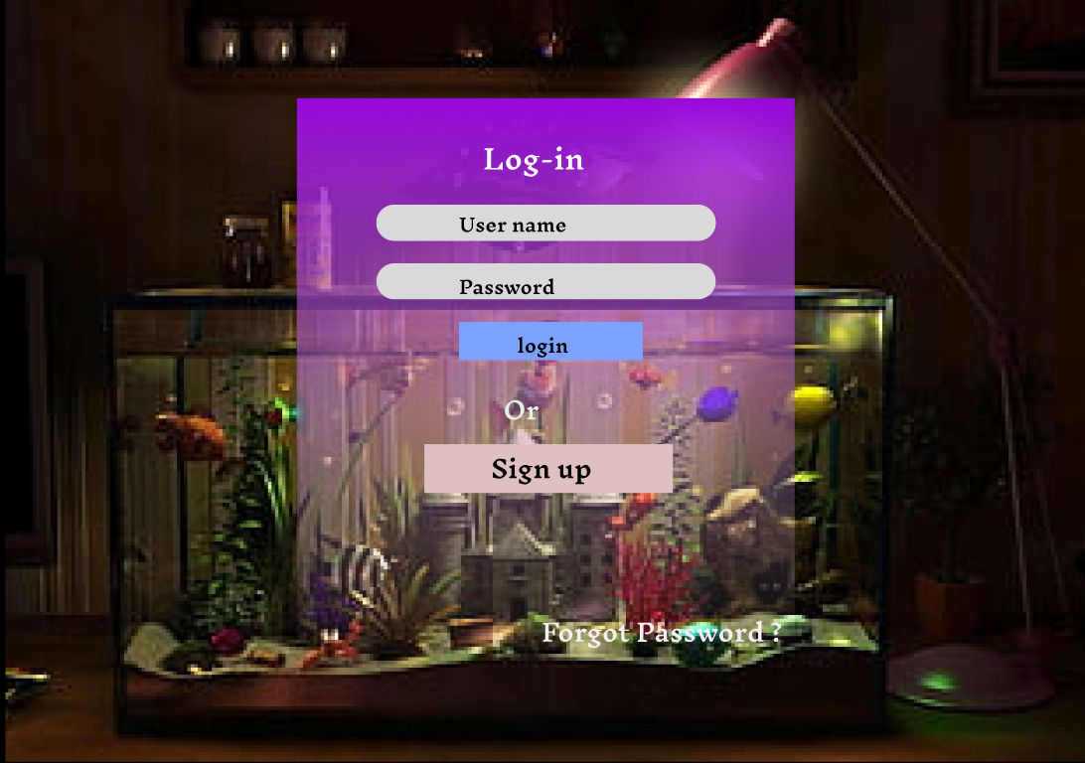
Figma

Slide 7
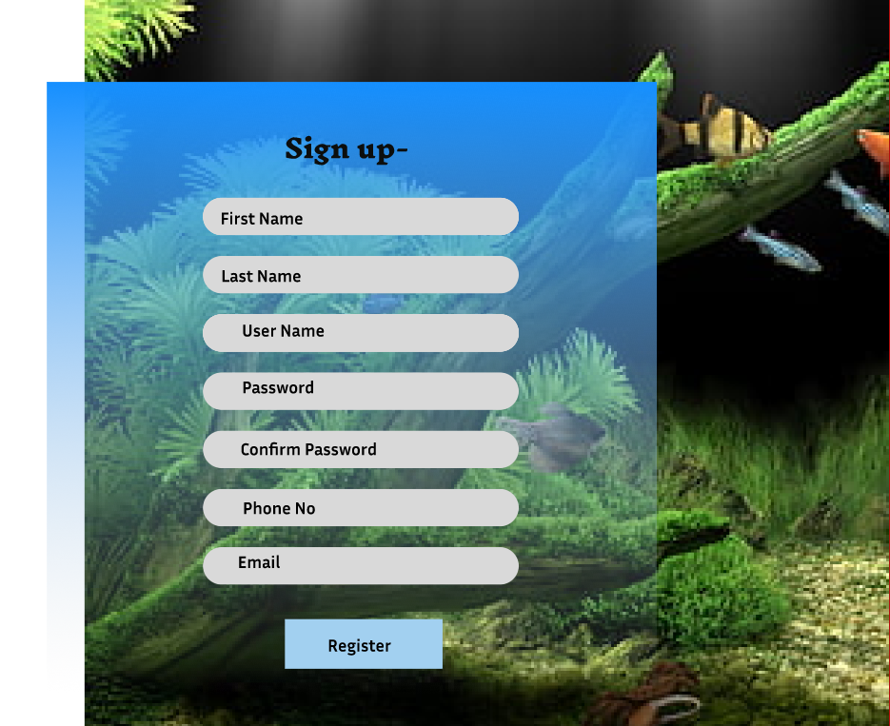

Slide 8
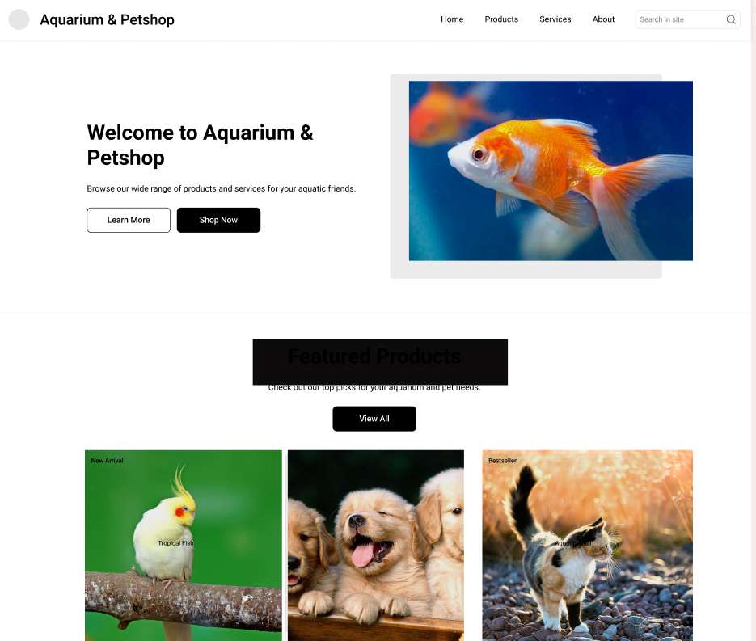

Slide 9
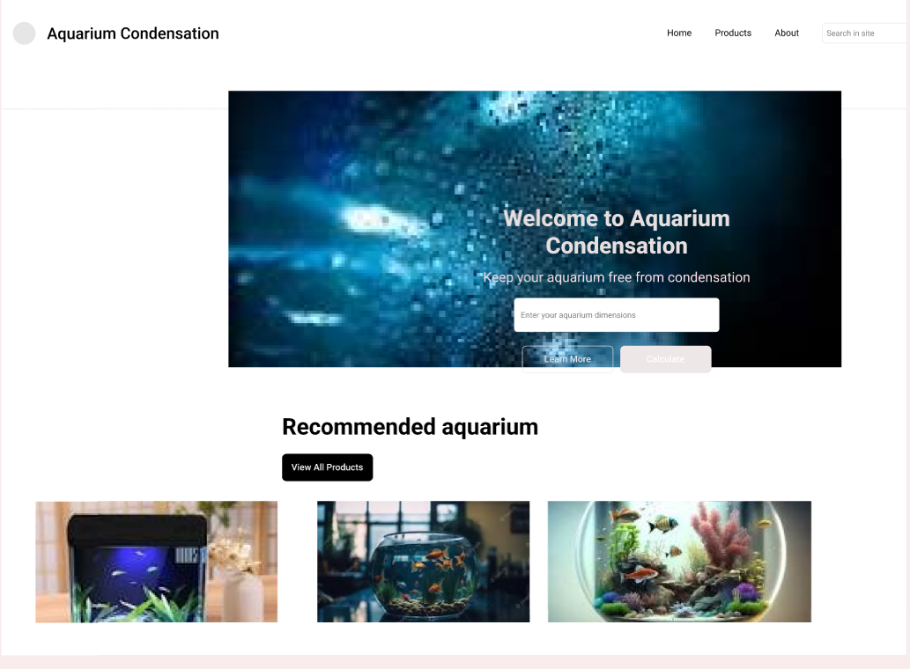

Slide 10
System Study
Project Gathering
Project Overview?
The Aquarium and Pet Shop Management System is a web-based platform designed to streamline the management of virtual aquariums and pet shops. It facilitates the organization, sale, and tracking of diverse aquatic life and pet-related products. This system caters to administrators, pet shop owners (dealers), and customers, providing each with specific functionalities.
To what extend the system is proposed for?
The proposed "Aquarium and Pet Shop Management System" is designed to provide a comprehensive solution for managing and operating virtual aquariums and pet shops. The extent to which the system is proposed for includes:
Pet Shop Management:
Dealers (pet shop owners) can efficiently manage their inventory of pets and aquariums, including adding, updating, and removing product listings.
Inventory management tools ensure accurate stock tracking and availability management.
Customer Shopping Experience:
Customers can browse a wide range of pets and aquariums with advanced search and filtering options to find the perfect product.
Customers can place orders, receive order status updates, and complete transactions (if payment integration is implemented).

Slide 11
Feedback and Interaction:
Customers can leave reviews and ratings for products, providing valuable feedback to dealers and helping other customers make informed decisions.
Dealers can respond to customer inquiries, reviews, and ratings, fostering communication and customer satisfaction.
Administrator Control:
Administrators have full control over the system, including user account management, system configuration, and reporting.
Admin-specific dashboards and interfaces allow for efficient system management.
Security and Data Privacy:
The system implements robust security measures, including data encryption and secure user authentication, to protect user data and transactions.
It ensures compliance with data privacy regulations.
Responsive Design and Accessibility:
The system is designed to be responsive, ensuring compatibility across various devices and screen sizes.
It can be deployed on web hosting platforms, making it accessible to users with an internet connection from various locations.

Slide 12
Reporting and Analytics:
Dealers and administrators can generate reports on sales, inventory, user activity, and more.
Analytics tools provide insights into user behavior and system performance.
Continuous Improvement:
The system incorporates a feedback mechanism for both customers and dealers, enabling continuous improvement in product listings and user experience.
Optional Payment Integration:
The system optionally integrates with payment gateways, allowing for secure online transactions.
Customization and Configuration:
Admins can configure system settings, including language, currency, and other behaviors to suit specific requirements.
The system is proposed to streamline the management and shopping experience related to aquatic life and pet products. It caters to the needs of pet shop owners, administrators, and customers, offering a user-friendly and efficient platform for their respective roles. Additionally, it provides valuable reporting and analytics tools for data-driven decision-making. The system can be further customized or extended based on specific project requirements and user feedback.

Slide 13
specify the viewers/public which is to be involved in the system?
In the "Aquarium and Pet Shop Management System," various stakeholders and users will interact with the system. Here's a specification of the viewers and the public who are expected to be involved:
Administrators:
1.Pet shop owners
2.Customers
3.Potential Customers (Public)
4.Developers and IT personnel
5.Regulatory bodies or auditors
6. Pet Shop Owners (Dealers)
List the modules included in this project?
1.User Authentication and Access Control:
User Registration
User Login
User Roles (Admin, Pet Shop Owner, Customer)
User Profile Management
Password Reset
2.Product Management:

Slide 14
Add New Pet or Aquarium Listings
Update Pet or Aquarium Details
Delete Pet or Aquarium Listings
View Pet or Aquarium Listings
3.Inventory Management:
Track Pet and Aquarium Stock Levels
Set Product Availability Status
Update Product Prices and Quantities
4.Order Processing:
Order Placement by Customers
Order Notification to Pet Shop Owners
Order Fulfillment and Status Updates
5.Search and Filtering:
Search Pets and Aquariums by Species, Price, Location, etc.
Apply Filters to Narrow Down Results
6.User Interface and Display:
Display Pet and Aquarium Listings
Dynamic Web Page Generation using Django Templates
User-Friendly Interfaces for Data Entry and Interaction

Slide 15
7.Responsive Design:
Ensure Compatibility Across Various Devices and Screen Sizes
Optimize Layout for Desktop and Mobile Browsing
8.Admin Dashboard and Reporting:
Admin-Specific Interface for Managing Users and Content
Generate Reports on Sales, Stock Levels, etc.
9.Notifications and Alerts:
Notify Users of Product Updates, Promotions, etc.
Send Order Confirmation and Status Updates
10.Payment Integration (Optional):
Allow Customers to Make Payments Online
Integrate Payment Gateways for Secure Transactions
11.Feedback and Reviews:
Allow Customers to Leave Reviews and Ratings
Provide Feedback Mechanism for Continuous Improvement
12.Settings and Configuration:
Admin Panel for Configuring System Settings

Slide 16
Customize Application Behavior (e.g., currency, language)
13.Security and Data Privacy:
Implement Data Encryption and Protection
Ensure Secure User Authentication and Authorization
14.Reporting and Analytics:
Generate Reports on Sales, Inventory, User Activity, etc.
Utilize Analytics to Gain Insights into User Behavior
15.Support and Helpdesk:
Provide User Support and Assistance
Offer Help Documentation or chat bot
identify the users in this project?
1.Administrator
2.Dealer
3.Customer
4.Delivery Man

Slide 17
Who owns the system?
System is related to which firm/industry/organization ?
The system is related to Ecommerce. The platform For Selling and buying Aquarium and Pets
Details of persons that you have contacted for data collection?
Royal farm and aquarium shop
Feasibility is defined as the practical extent to which a project can be performed successfully. To evaluate feasibility, a feasibility study is performed, which determines whether the solution considered to accomplish the requirements is practical and workable in the software.
how would the organisation cope if the system was not implemented ?
If the "Aquarium and Pet Shop Management System" were not implemented, the organization would likely face several challenges and inefficiencies in managing its aquarium and pet shop
2. what are the problems with current process and how would a new system help alleviate these problems ?
Implementing the new "Aquarium and Pet Shop Management System" would alleviate current problems such as manual inventory management, limited accessibility, and inefficient communication. The system aquarium and pet shop management automates processes, improves data accuracy, and enhances accessibility for customers and dealers.

Slide 18
3. what direct contribution will the system makes to the business objectives and requirements ?
The "Aquarium and Pet Shop Management System" directly contributes to business objectives by improving operational efficiency, increasing sales through online accessibility, reducing data errors, and facilitating growth, thereby enhancing profitability and customer satisfaction
4. can information be transferred to and from other organization systems ?
Yes, the system can facilitate data transfer to and from other organizational systems, allowing for seamless integration and data synchronization, which enhances operational efficiency and accuracy.
5. does the system require technology that has not previously been used in the organisation ?
The aquarium and pet shop management system may require some technology components, such as web-based interfaces and database management systems..
6. what must be supported by the system and what need to be support ?
The aquarium and pet shop management system must support critical functionalities such as inventory management, user authentication, online accessibility, and order processing of aquarium or pets. It needs to support features that enhance user experience, including search and filtering options, notification systems, and user-friendly interfaces

Slide 19
Technical feasibility-
The term "technical feasibility" in relation to the "Aquarium and Pet Shop Management System" refers to determining if the proposed system can be successfully constructed from a technological perspective. It entails assessing the system's implementation's technology, infrastructure, and resource needs. Additionally, it aids in spotting potential technical difficulties and ensuring that the technology selected complies with the project's objectives and specifications.
Operational feasibility-
Operational feasibility in the context of the "Aquarium and Pet Shop Management System" evaluates how well the proposed system can be incorporated into the company's current operations and how user-friendly it will be. Operational feasibility guarantees that the suggested "Aquarium and Pet Shop Management System" may be successfully integrated into the company's everyday operations, resulting in operational efficiency, user satisfaction, and regulatory compliance. To reduce hiccups during the switch to the new system, proper planning and change management are also required.
Economic feasibility
The "Aquarium and Pet Shop Management System’s economic viability is evaluated in terms of whether the system is financially feasible and whether the anticipated benefits outweigh the costs of its creation and maintenance. Making decisions about whether to move forward with the development of the "Aquarium and Pet Shop Management System" requires doing an economic feasibility analysis. It aids businesses in determining the project's financial viability and guarantees that the anticipated benefits match the associated expenses and risks.

Slide 20
thank you

